Slide 1

COMMAND LINE
CALCULATOR
PRESENTED BY:-
Humayra Afia Hany
ID: 221002338
MD Abu Sufian
ID: 221002136

Slide 2

1
Introduction
CONCENTS
2
Implementation
3
Result
4
Conclusion

Slide 3
PART 01
Introduction
A Simple Arithmetic Expression Compiler. It reads arithmetic expressions from the user, breaks them down into tokens, parses these tokens according to the rules of arithmetic, and evaluates the expression to produce a result.

Slide 4

Design Goals
Design a user-friendly compiler to make it easy for users to input and evaluate typical arithmetic expressions
Respect operator precedence and accurately handle nested parentheses
Develop a parser to interpret tokens and construct a structure representing the
expression
Create a tokenizer to break down input arithmetic expressions into tokens such as integers, operators, and parentheses

Slide 5
PART 02
Implementation
Our Command Line Calculator, where precision, efficiency, and user-friendliness converge to simplify arithmetic expression evaluation in C programming.

Slide 6
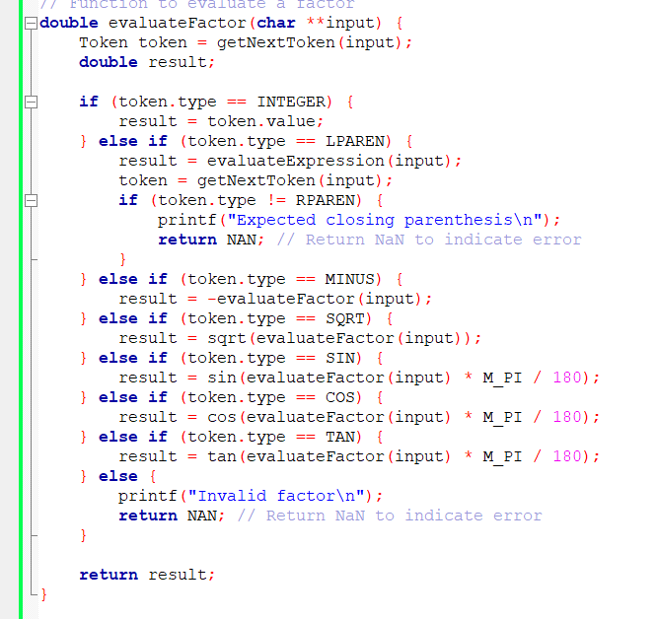
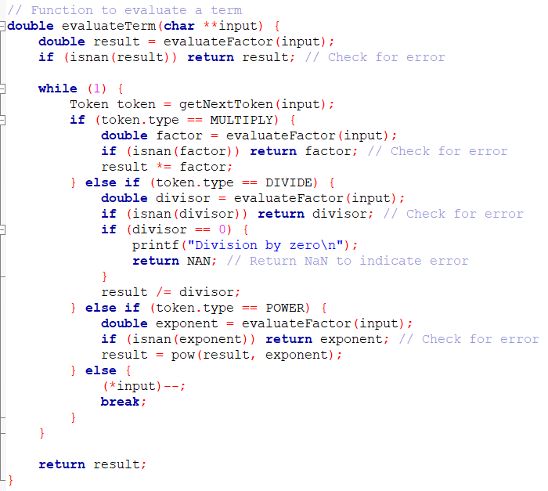

Some parts of the code

Slide 7
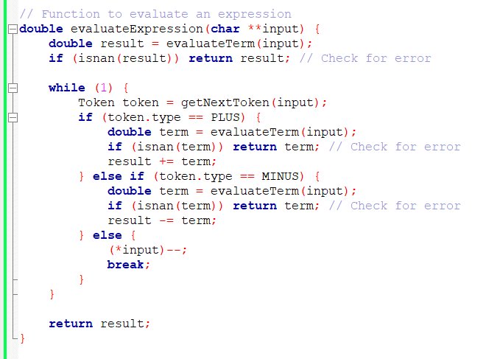
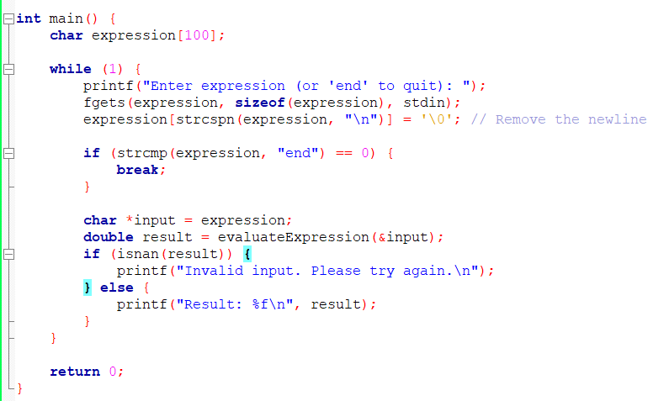
Some parts of the code

Slide 8

PART 03
RESULT
The Command Line Calculator project has yielded a functional and efficient solution for parsing and evaluating arithmetic expressions in the C programming language

Slide 9
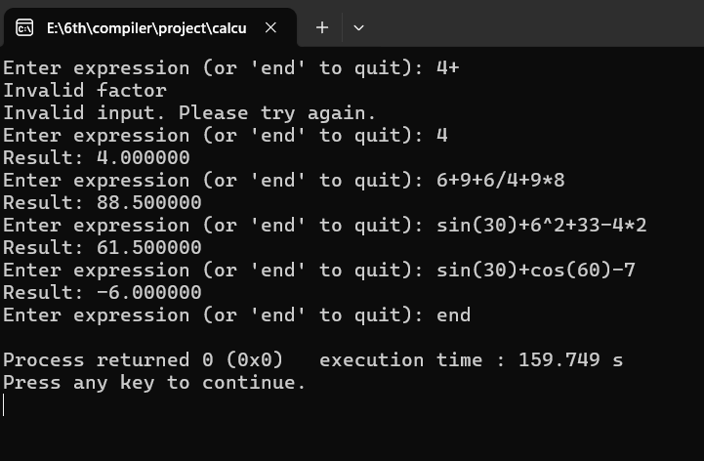
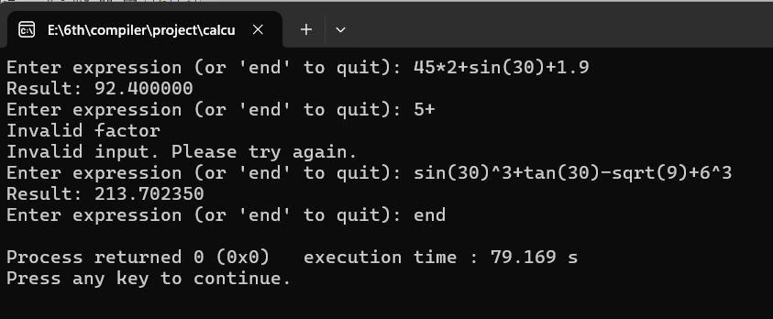
OUTPUT

Slide 10

Limitations
Expression Complexity
Lack of Optimization
Its capabilities may be limited with highly complex expressions, potentially leading to parsing errors
Evaluates arithmetic expressions without implementing optimization techniques, which may impact performance in scenarios with resource constraints
Limited Error Reporting
Platform Dependency
The compiler has error handling but may not provide detailed error messages, which can make debugging complex expressions difficult
Performance may vary based on platform-specific dependencies, optimizations, and architecture differences

Slide 11

Scope of Future Work
Optimization Techniques
Error Recovery Mechanisms
Implementing advanced optimization techniques to enhance compiler efficiency and performance
Enhancing the compiler's error handling mechanisms to provide more informative error message
Language Extensions
Cross-Platform Compatibility
Extending the compiler to support additional language features beyond basic arithmetic expressions
Ensuring cross-platform compatibility by adapting the compiler codebase to work seamlessly on different operating systems

Slide 12
Thanks for
Your attention

